Slide 1
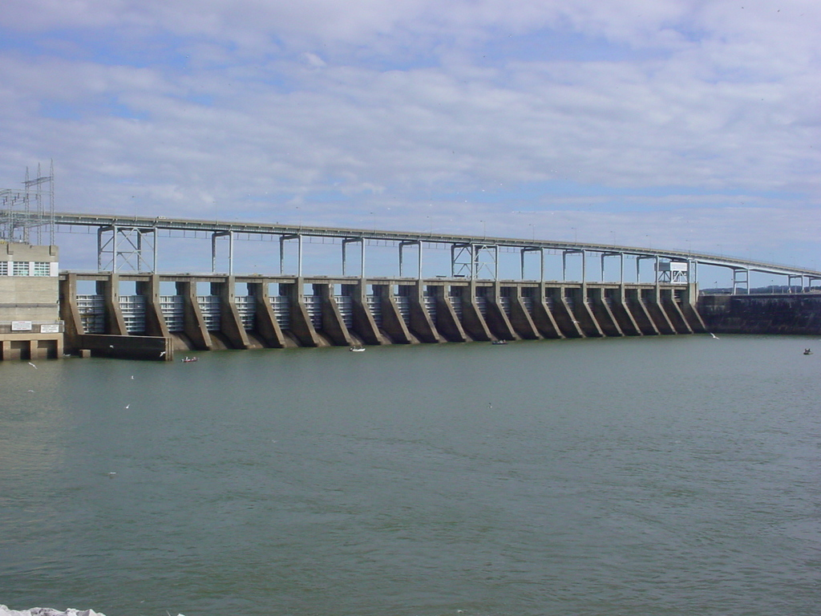
Fisheries Management Asian Carp Projects
Michael Clark
Reservoir Biologist

Slide 2
Asian Carp Projects
Asian Carp Harvest Incentive Program (ACHIP)
Larval sampling to determine reproductive success
Standard gill net sampling
Tagging and movement study
Barriers

Slide 3
Asian Carp Harvest Incentive Program (ACHIP)
TWRA pays contracted commercial fishers and markets an additional $0.10 per pound for harvesting Asian Carp from Kentucky, Barkley, Cheatham, and Old Hickory reservoirs.
The commercial fisher receives $0.07 per pound above minimum market value of $0.13 and the wholesale fish market receives $0.03 per pound for keeping up with poundage harvested and submitting required paperwork.

Slide 4
ACHIP
To date approximately 4.0 million pounds have been removed from Kentucky and Barkley reservoirs through this program since September, 2018.
There are 3 participating markets with 16 contracted commercial fishermen.
TWRA assists further by supplying gill net webbing for commercial fisherman in the program.
Kentucky Department of Fish and Wildlife Resources has a similar program that has removed an additional 12.7 million pounds from Kentucky and Barkley reservoirs since 2013.
Amendments to the ACHIP program are currently being reviewed to provide additional funds to the wholesale market.

Slide 5
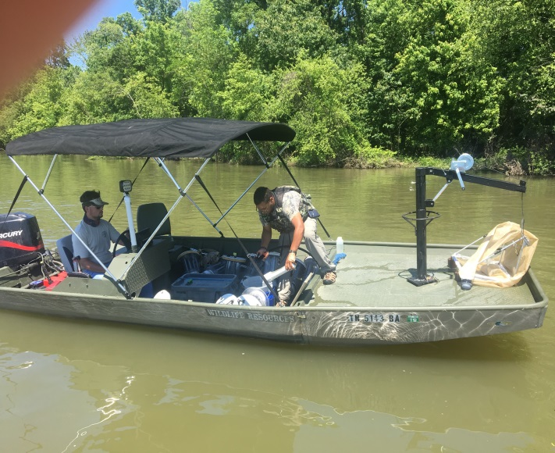
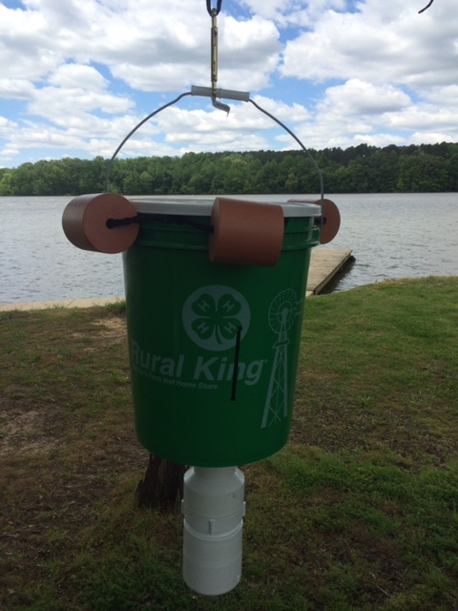
Larval Sampling to Determine Reproductive Success
2016 – 80 light trap sets
2017 – 230 light trap sets
250 larval tows
2018 – 270 light trap sets
300 larval tows
55 mini fyke net sets
2019 – 280 light trap sets
290 larval tows
80 mini fyke net sets
Asian Carp reproduction has not been
documented in either reservoir since 2016.
Larval tow boat
Mini Fyke net
Larval Light Trap

Slide 6
Standardized Gill Netting
To determine Asian Carp movement and leading edge distribution, standardized gill netting sample sites have been established in Kentucky and Barkley reservoirs.
Samples were collected in May, July, and November.
237 silver carp were collected in Kentucky Reservoir and 47 Silver Carp were collected in Barkley Reservoir during sampling efforts in 2019.
Grass Carp and Bighead Carp were also collected.

Slide 7
Tagging and Movement Study
A joint effort between the states of Alabama, Mississippi, Tennessee, and Kentucky Wildlife agencies. Murray State University, Tennessee Tech University, and Mississippi State University are also involved with data collection and data analyses.
30+ receivers have been placed throughout Tennessee and Cumberland river systems from Kentucky and Barkley dams to as far upstream as Guntersville Dam.
Over 400 fish have been tagged throughout the Tennessee River system.

Slide 8
Barriers
U. S. Fish and Wildlife Service and partnering states have purchased a Bio Acoustic Fish Fence System (BAFF)to be installed at Barkley Lock for a study in deterring fish with sound, bubble curtains, and light.
U. S. Geological Survey has developed deterrent systems as well to study the effectiveness of inhibiting the upstream migration through locks.
Nickajack, Pickwick, and Reelfoot dam structures are being considered as additional potential test sights for these systems.
Notes:
A BAFF is currently being installed at Barkley Lock and Dam. This BAFF system is a joint project with a private vendor, USFWS, and partnering states. The system uses sound, bubbles, and light to deter Asian carp from entering the lock and accessing Barkley and Kentucky reservoirs.

Slide 9
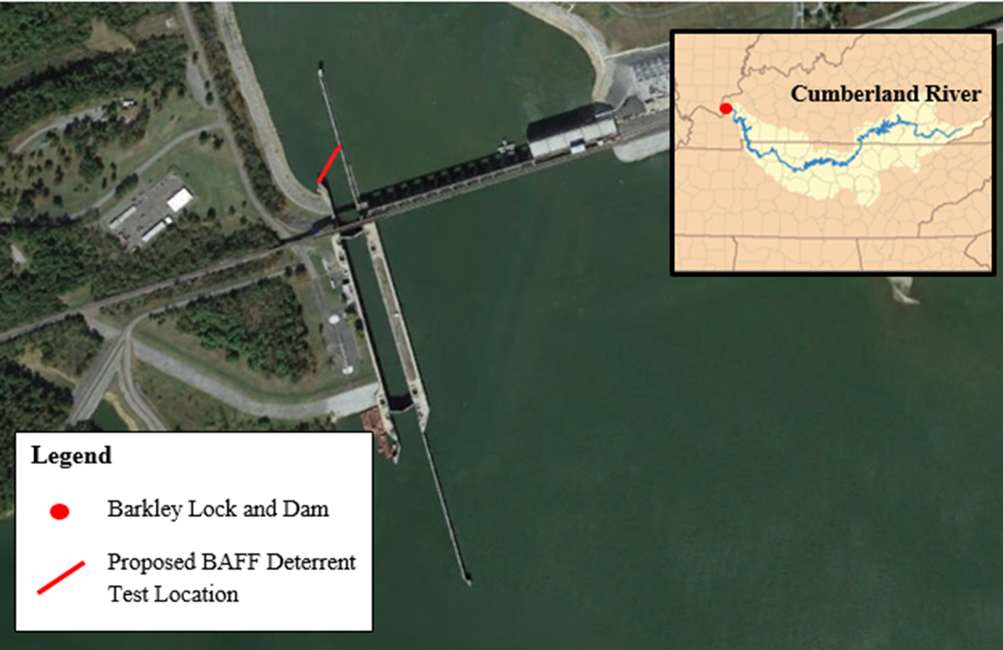

Slide 10
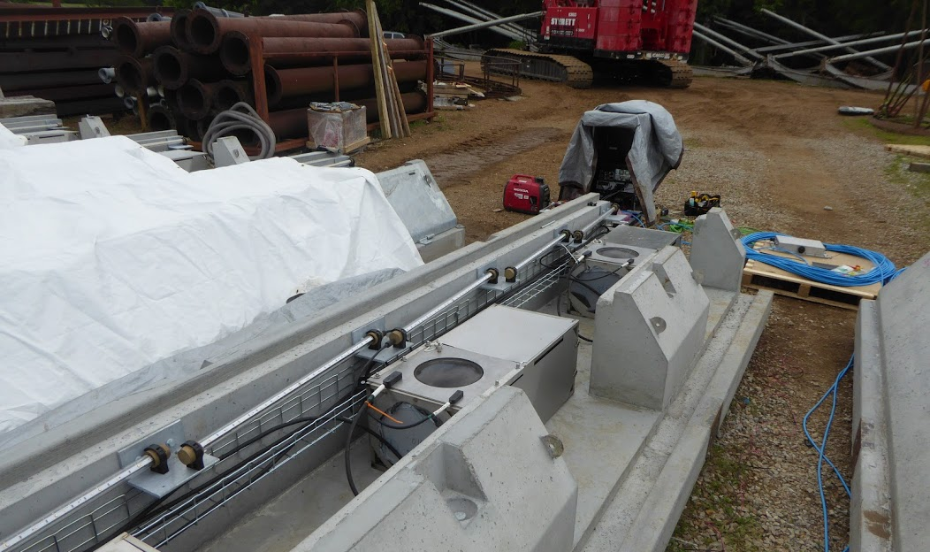
Barrier System
The barrier utilizes sound, bubbles, and light to deter movement of Asian carp into and through the locks at Barkley Tailwater.
Asian carp are sensitive to sound at designated frequencies and the bubbles maintain that sound in the water column to the surface.
The barrier has been in operation since March 2020.

